Slide 1
BREAST CANCER DIAGNOSIS
Presentation by:
SAMUEL DARTEH
Data Science MS
Group 4
Data Science MS

Slide 2

Introduction | Recap
The goal of the study is to create a model to predict the possible diagnosis of breast cancer—whether benign (healthy) or malignant (cancerous).
Data source: Breast Cancer Wisconsin (Diagnostic) dataset University of California (Irvine): http://archive.ics.uci.edu/dataset/17/breast+cancer+wisconsin+diagnostic
Features were computed from a digitized image of a fine needle aspirate (FNA) medical procedure of a breast mass, and relevant features selected.
Breast cancer is not only the commonest cancer amongst
women; it’s now the most diagnosed cancer worldwide
and the second deadliest second to lung cancer.
(https://www.cancer.net/)
Early detection is key to the fight against breast cancer.

Slide 3
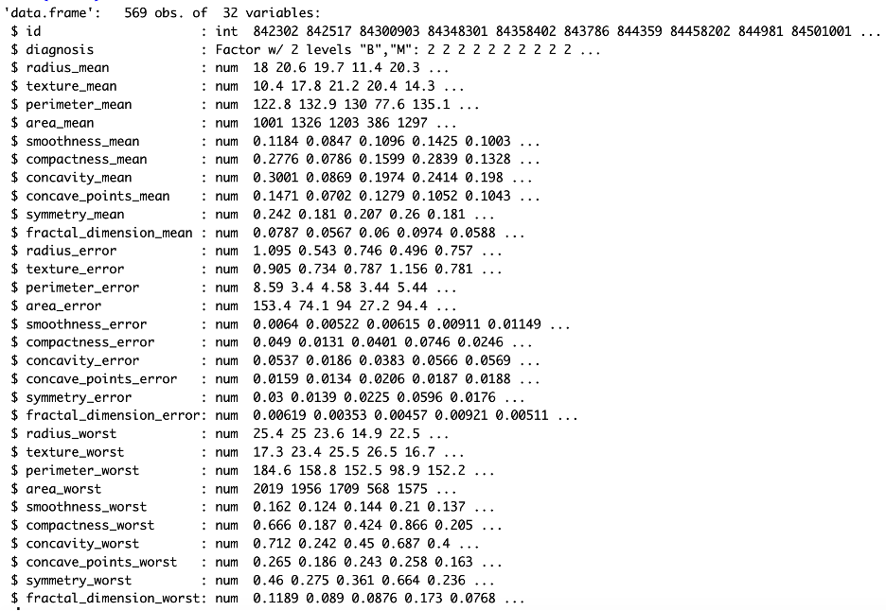
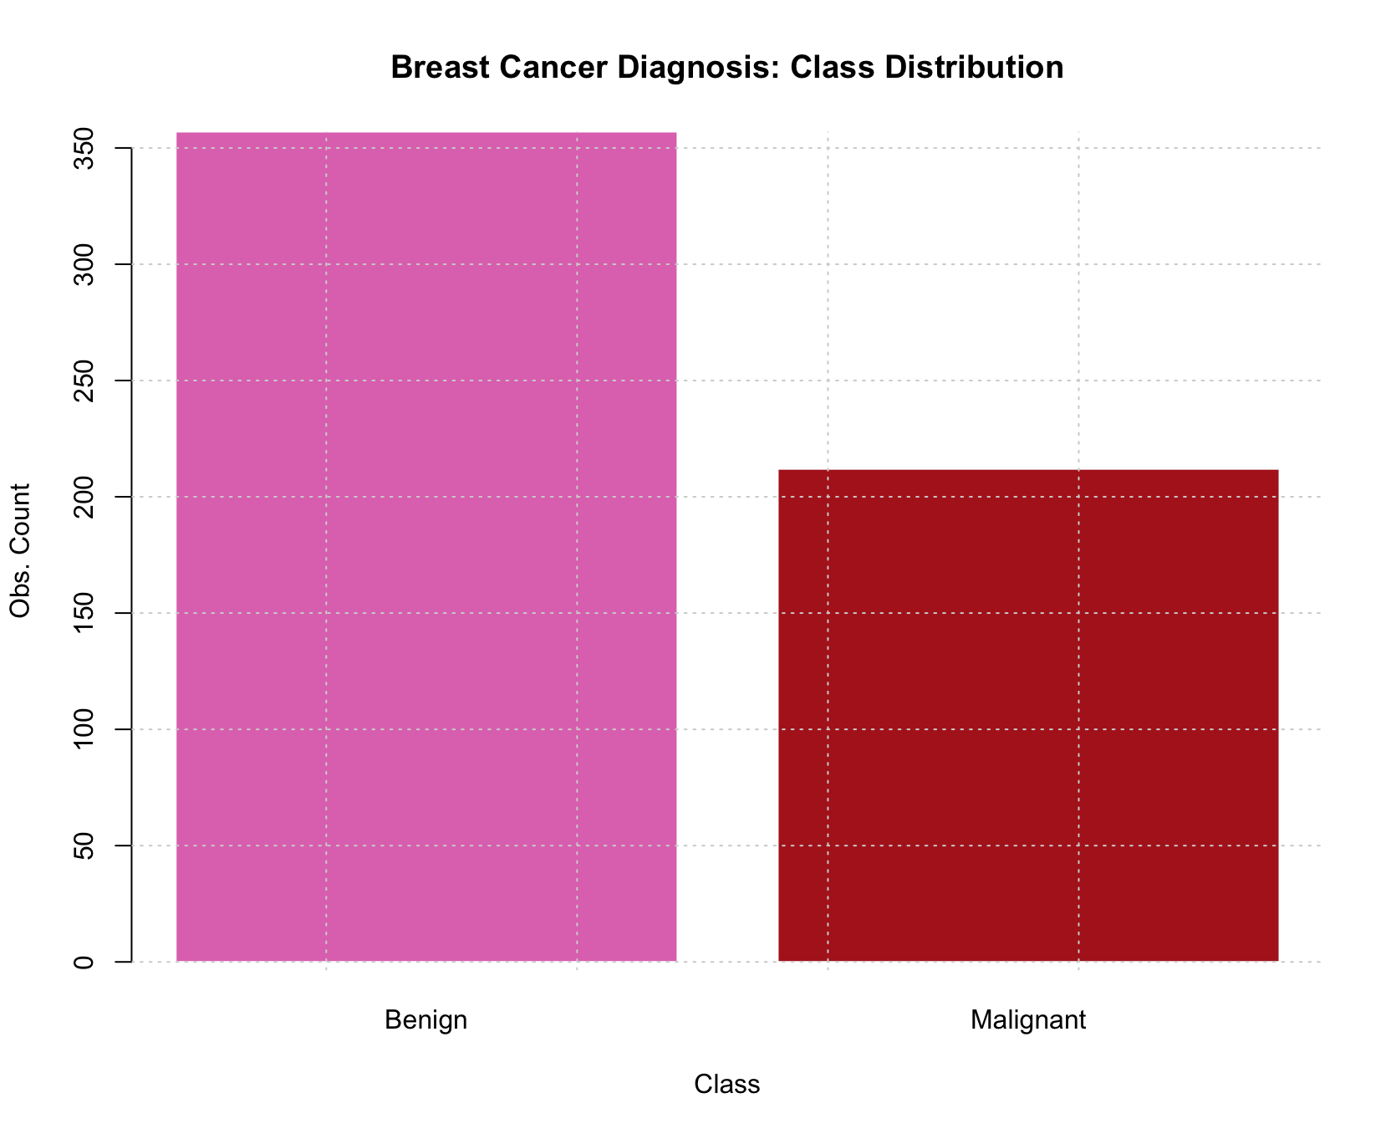
Data Structure
Sample size: 569 observations
30 predictors
— all variables were continuous.
— no categorical variable.
Mean, standard error (se), and worst values computed for 10 selected features.
1 response variable (Diagnosis)
Categorical — Classification problem
Encoded as factor with 2 levels: B, M
Unbalanced distribution
Benign (B): 357 (63%),
Malignant (M): 212 (37%)
Breast Cancer Diagnosis

Slide 4
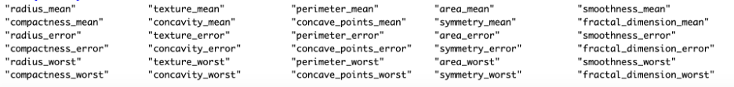
Data Structure
Predictor | Description
id | Identifier for each sample
diagnosis | Response—Benign (B) or Malignant (M)
radius | Mean distances from center to points on the perimeter
texture | Standard deviation of gray-scale values
perimeter | Perimeter of the tumor cells
area | Area of the tumor cells
smoothness | Smoothness of the tumor cells
compactness | Local variation in radius lengths
concavity | Perimeter^2 / area - 1.0
concave points | Severity of concave portions of the contour
symmetry | Number of concave portions of the contour
fractal dimension | Coastline approximation- 1
10 Features selected – each with “mean, error, worst” values
Breast Cancer Diagnosis

Slide 5
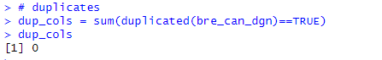
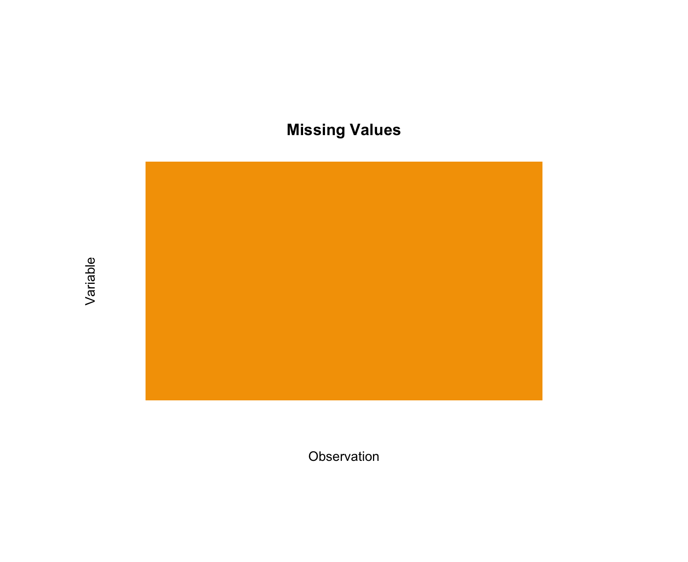
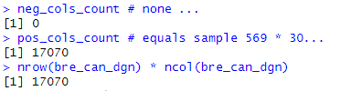
Data Anomalies
No duplicates found in data
There were no missing values. No imputation was necessary.
Negative values in data: None
No categorical variables
No degenerate (zero/near-zero variance) predictors
No dummy variable encoding
Breast Cancer Diagnosis

Slide 6
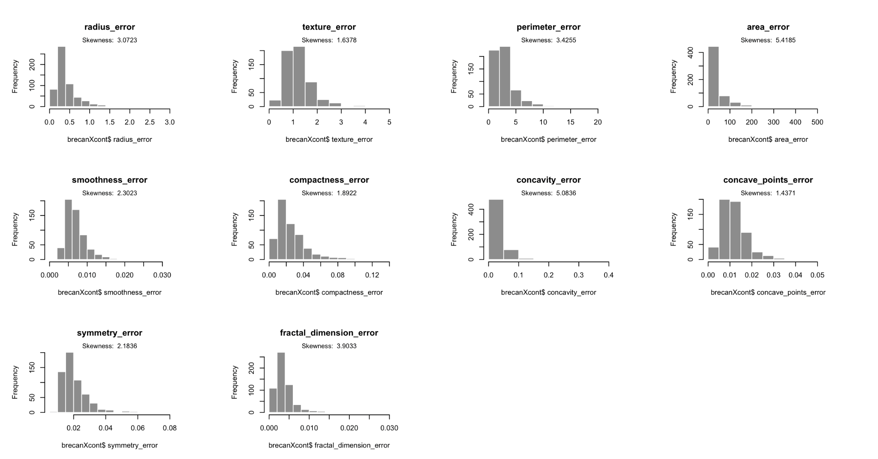
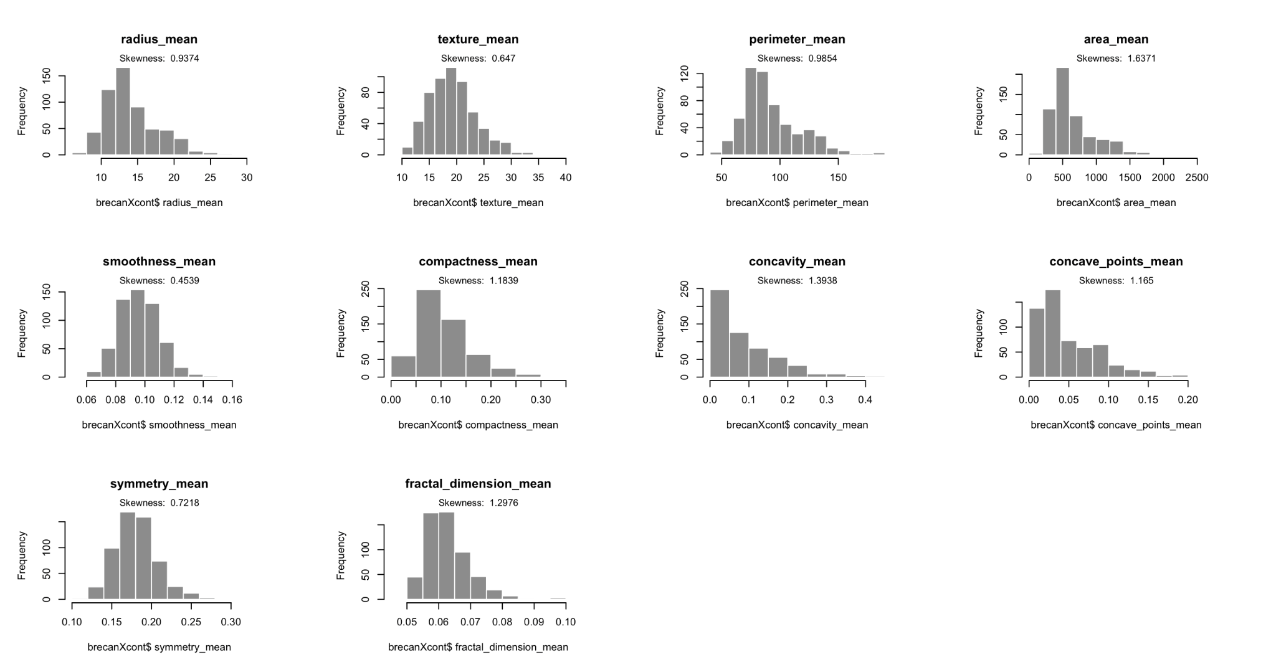
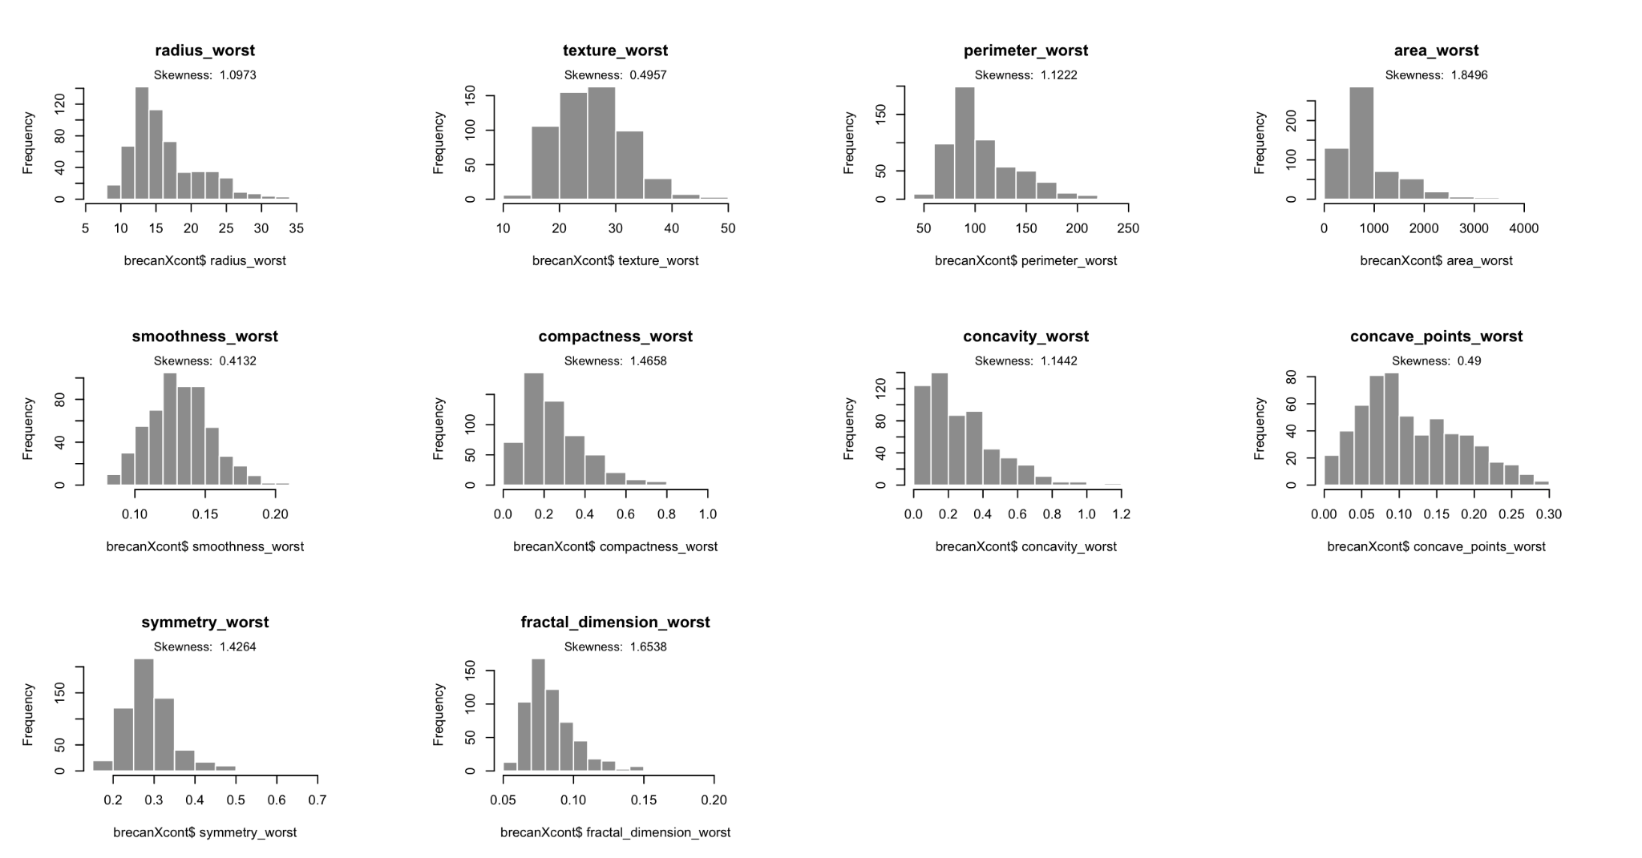
Data Anomalies: Skewness
skewness in error values
skewness in mean values
skewness in worst values
Breast Cancer Diagnosis

Slide 7
Data Anomalies: Skewness
22 of the 30 predictors are heavily skewed to the right
Predictor | Skewness | Interpretation
radius.mean | 0.9374168 | Moderately right skewed
texture.mean | 0.6470241 | Moderately right skewed
perimeter.mean | 0.9854334 | Moderately right skewed
area.mean | 1.6370654 | Heavily right skewed
smoothness.mean | 0.4539207 | Approximately symmetric
compactness.mean | 1.1838556 | Heavily right skewed
concavity.mean | 1.3938008 | Heavily right skewed
concave_points.mean | 1.1650124 | Heavily right skewed
symmetry.mean | 0.7217877 | Moderately right skewed
fractal_dimension.mean | 1.2976191 | Heavily right skewed
radius.se | 3.0723468 | Heavily right skewed
texture.se | 1.6377733 | Heavily right skewed
perimeter.se | 3.4254803 | Heavily right skewed
area.se | 5.4185001 | Heavily right skewed
smoothness.se | 2.3022616 | Heavily right skewed
Predictor | Skewness | Interpretation
compactness.se | 1.8922032 | Heavily right skewed
concavity.se | 5.0835502 | Heavily right skewed
concave_points.se | 1.4370701 | Heavily right skewed
symmetry.se | 2.1835728 | Heavily right skewed
fractal_dimension.se | 3.9033041 | Heavily right skewed
radius.worst | 1.0973059 | Heavily right skewed
texture.worst | 0.4956970 | Approximately symmetric
perimeter.worst | 1.1222227 | Heavily right skewed
area.worst | 1.8495814 | Heavily right skewed
smoothness.worst | 0.4132383 | Approximately symmetric
compactness.worst | 1.4657948 | Heavily right skewed
concavity.worst | 1.1441794 | Heavily right skewed
concave_points.worst | 0.4900213 | Approximately symmetric
symmetry.worst | 1.4263764 | Heavily right skewed
fractal_dimension.worst | 1.6538237 | Heavily right skewed
Breast Cancer Diagnosis

Slide 8
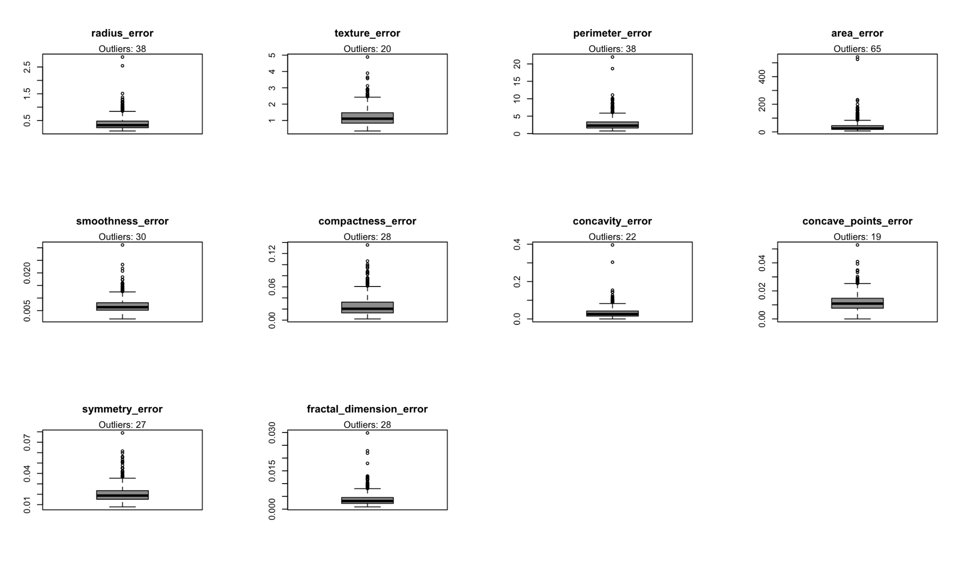
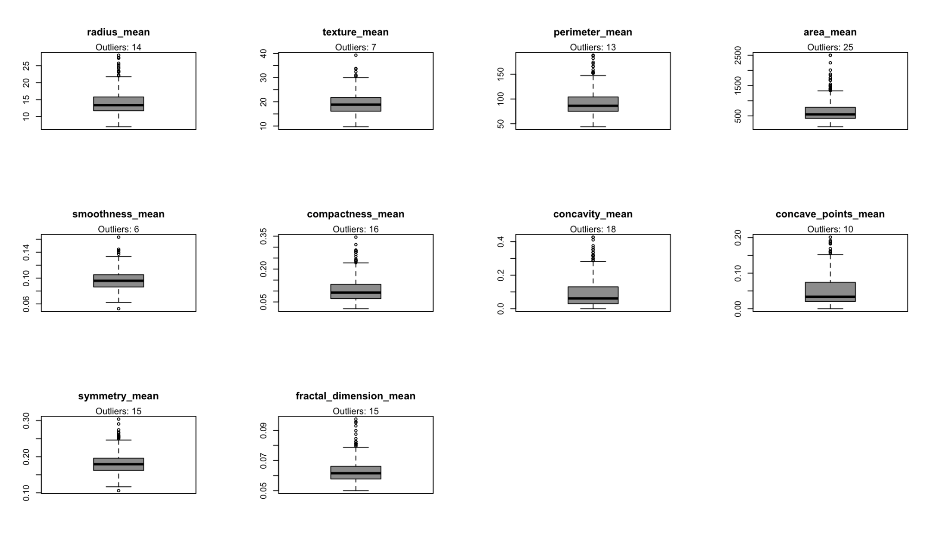
Data Anomalies: Outliers
Total outliers in data: 608
outliers in error values
outliers in mean values
outliers in worst values
Breast Cancer Diagnosis

Slide 9
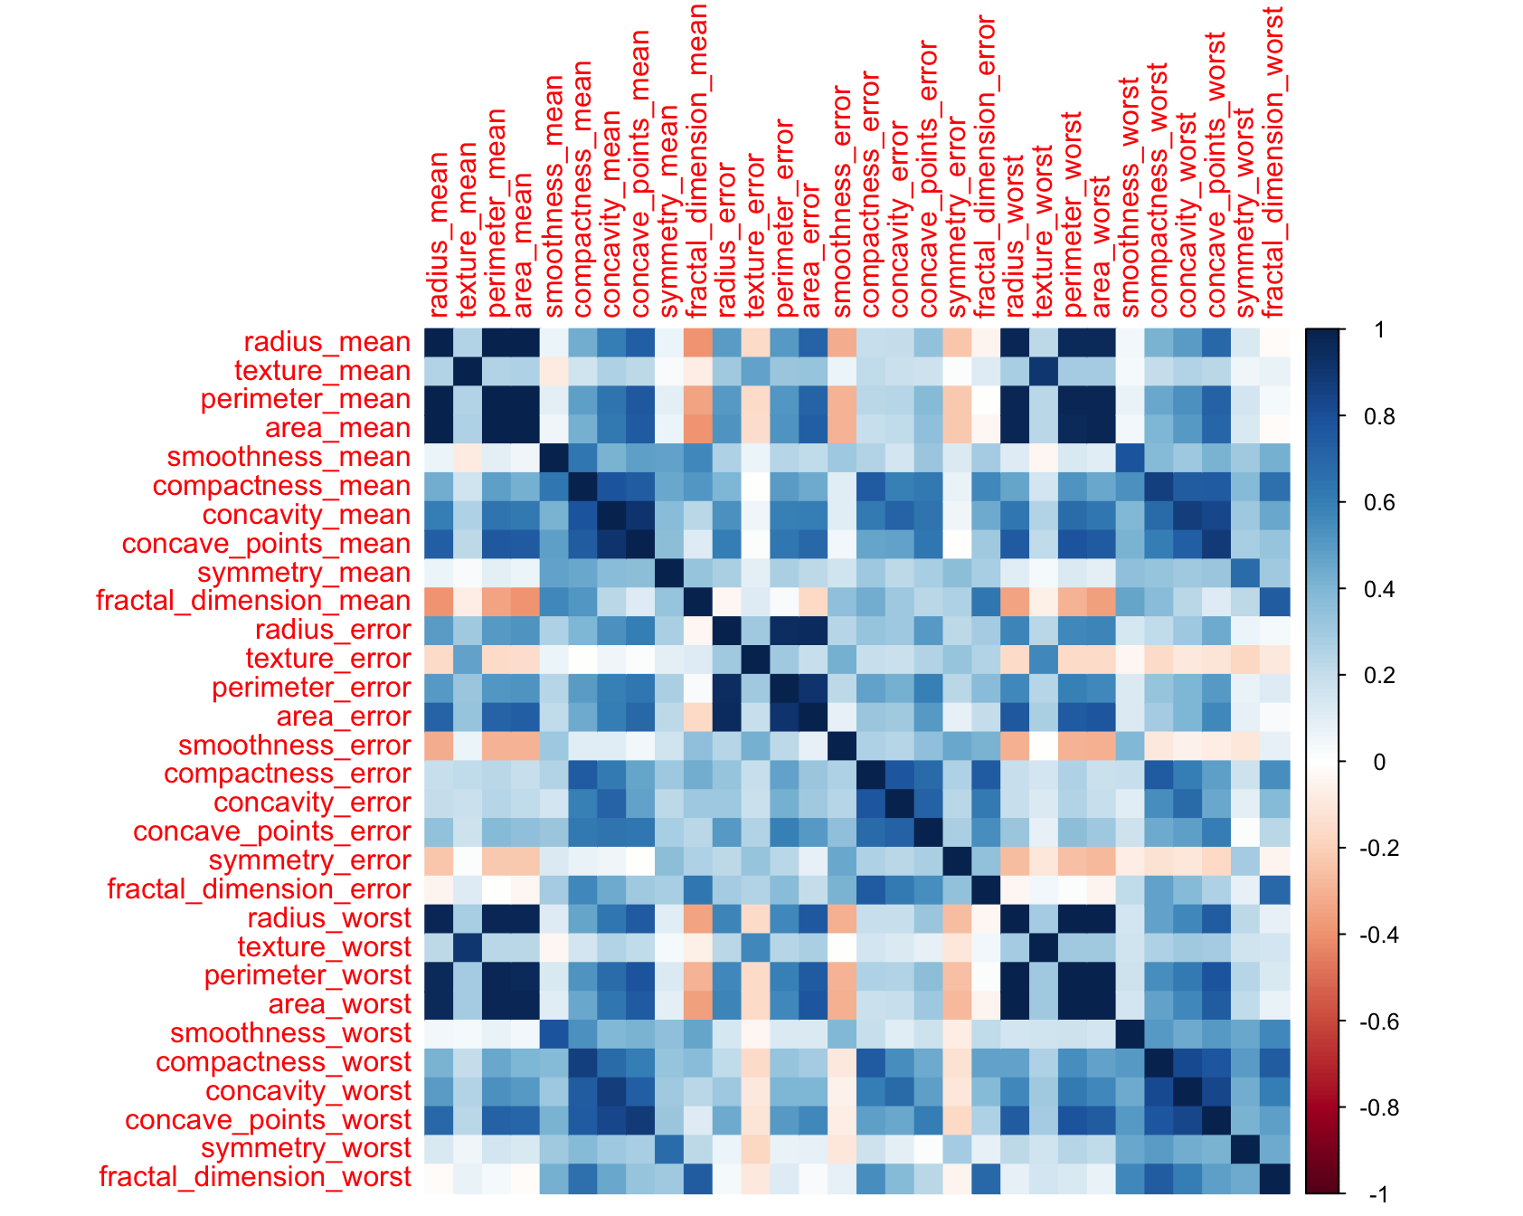
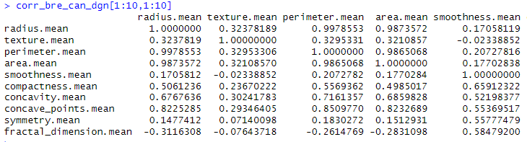
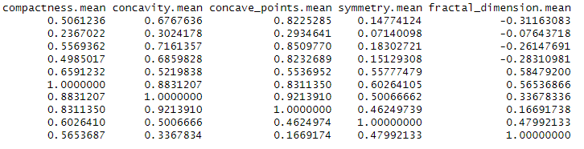
Data Anomalies: Correlation
Correlation matrix for all 30 predictors
Bivariate relationship between predictor features
Correlation coefficients of first 10 predictors (mean values) showing collinearity in data
Breast Cancer Diagnosis

Slide 10
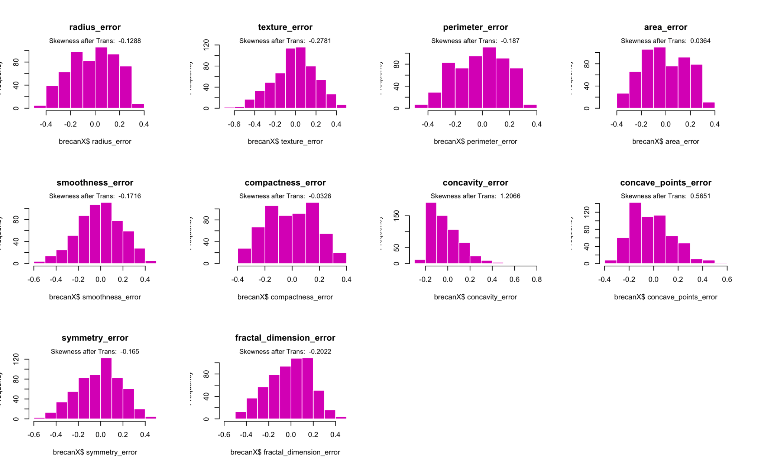
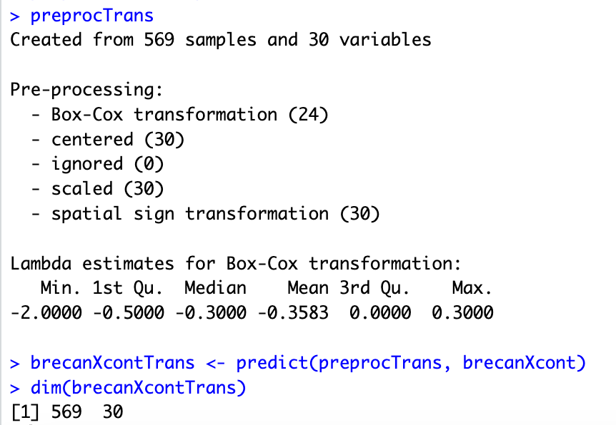
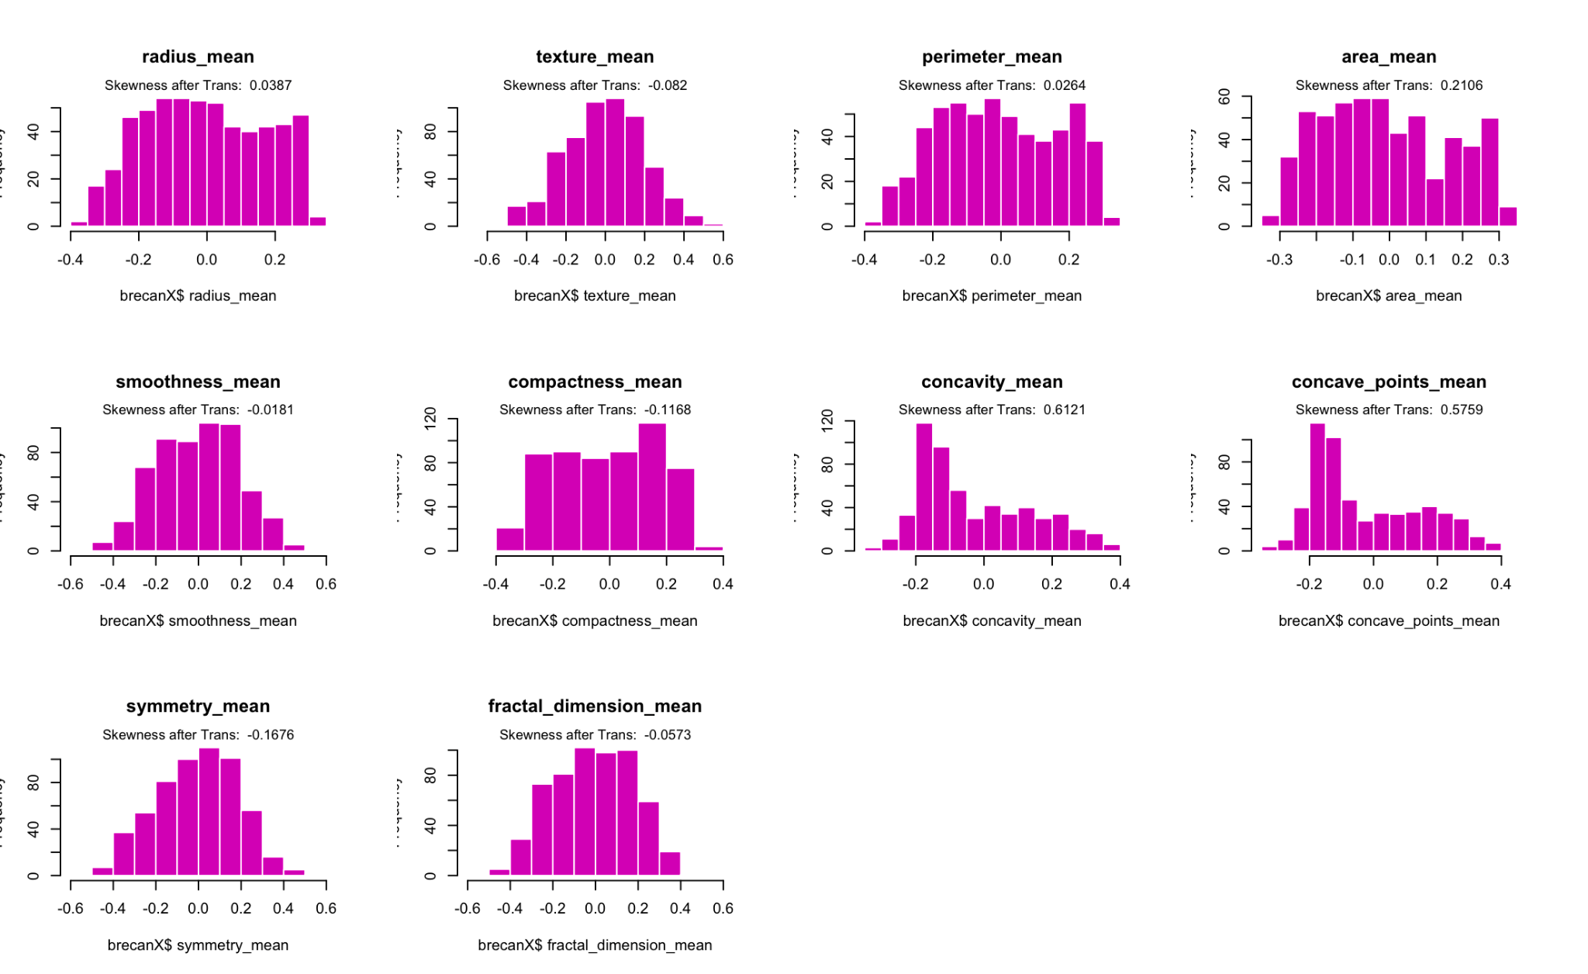
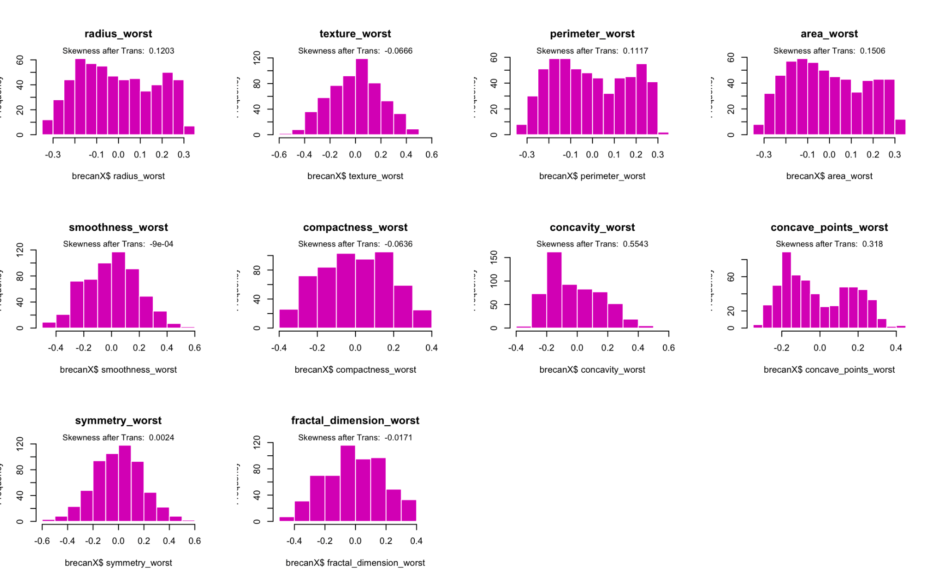
Data Transformation: BoxCox
Centering and scaling applied
BoxCox applied— Skewness reduced across predictors
Breast Cancer Diagnosis

Slide 11
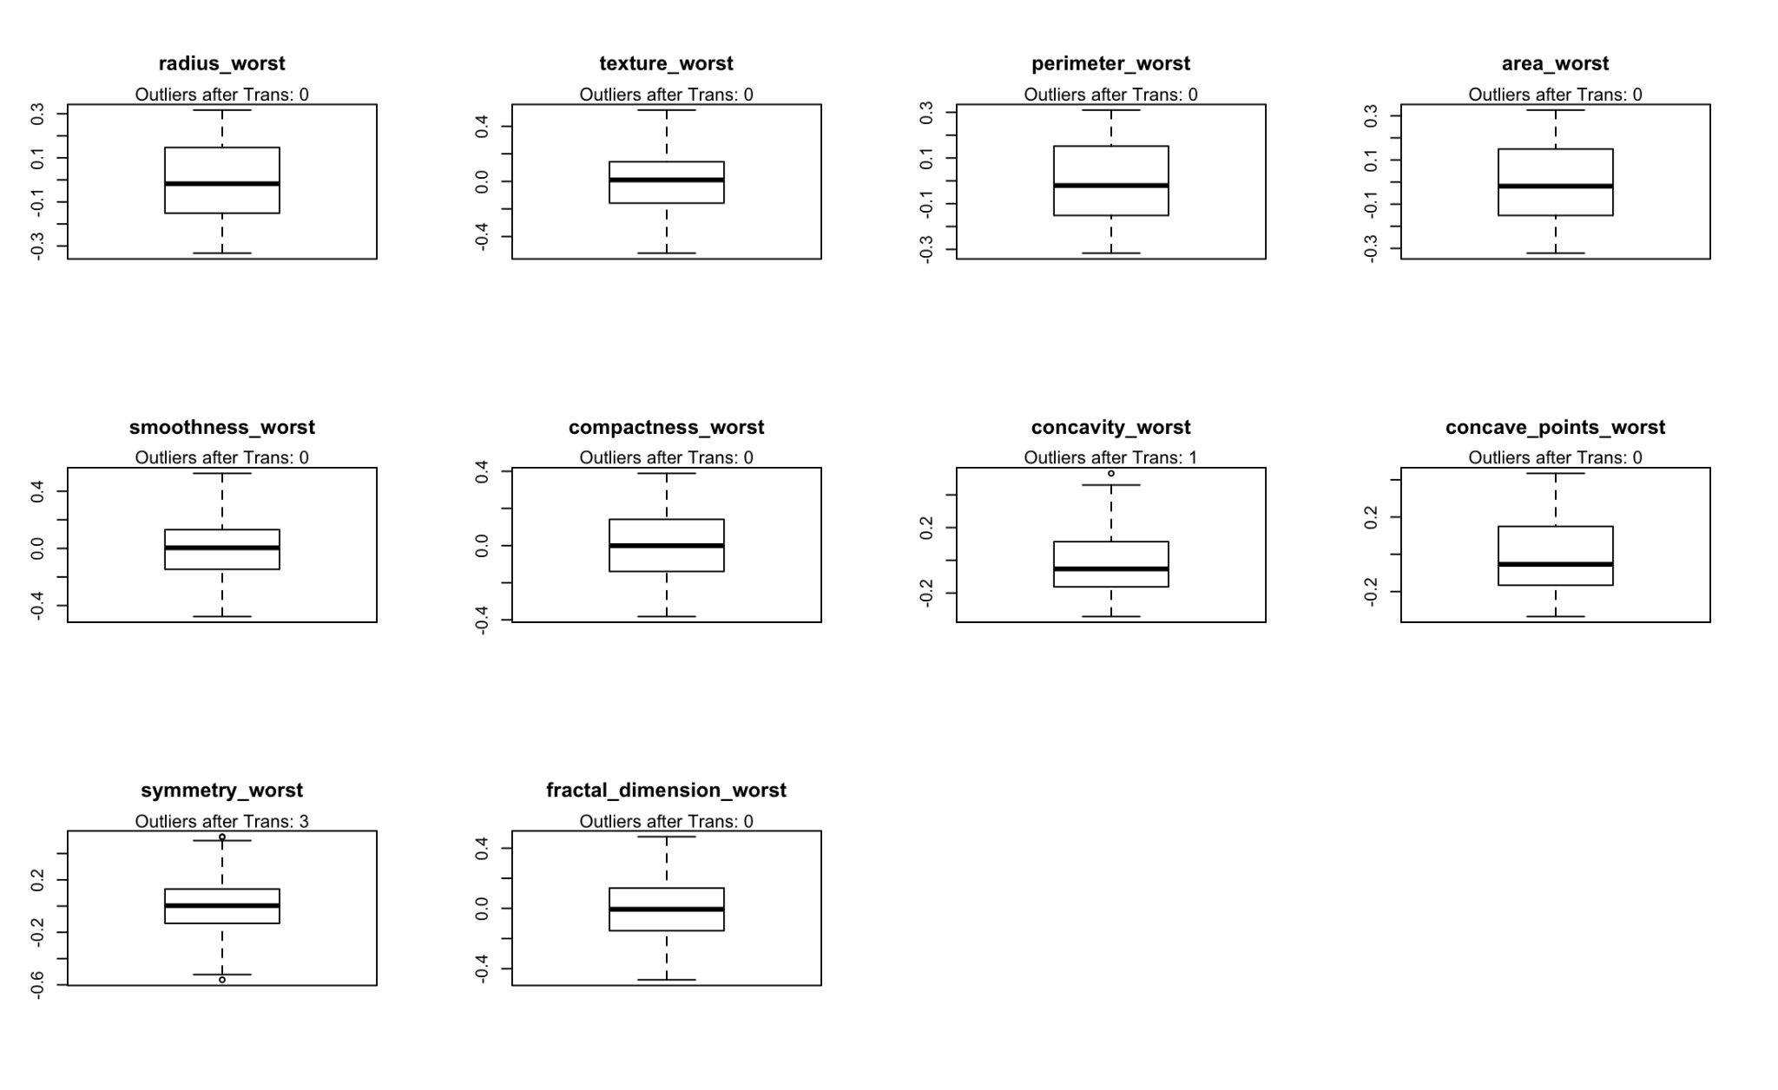
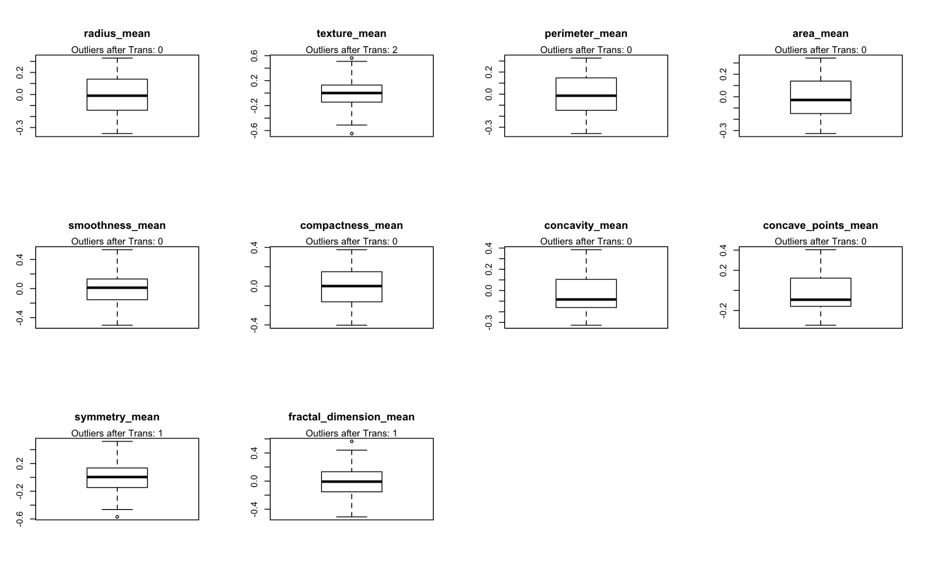
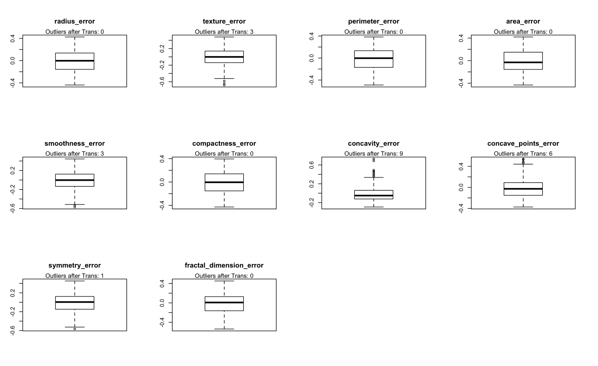
Data Transformation:
spatialSign
608 outliers
30 outliers
Breast Cancer Diagnosis

Slide 12
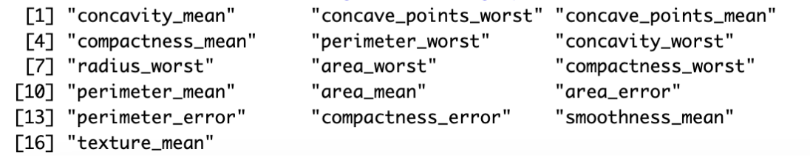
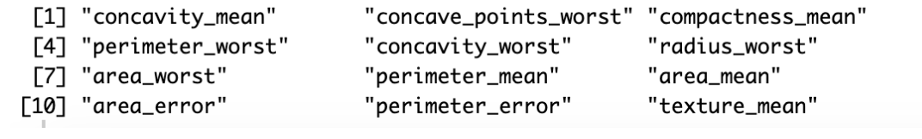

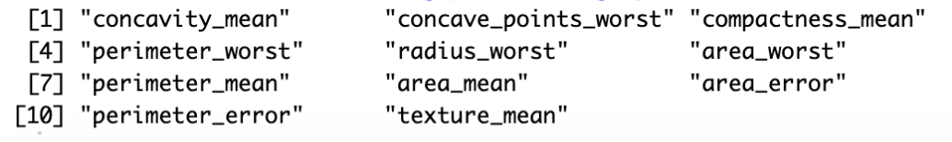
Data Transformation: Highly Correlated Predictors
Cut-off | Total | Predictors to remove
0.75 | 16
0.80 | 12
0.85 | 11
Applying cut-off value of 0.8 removed 12 out of 30 predictors.
Breast Cancer Diagnosis

Slide 13
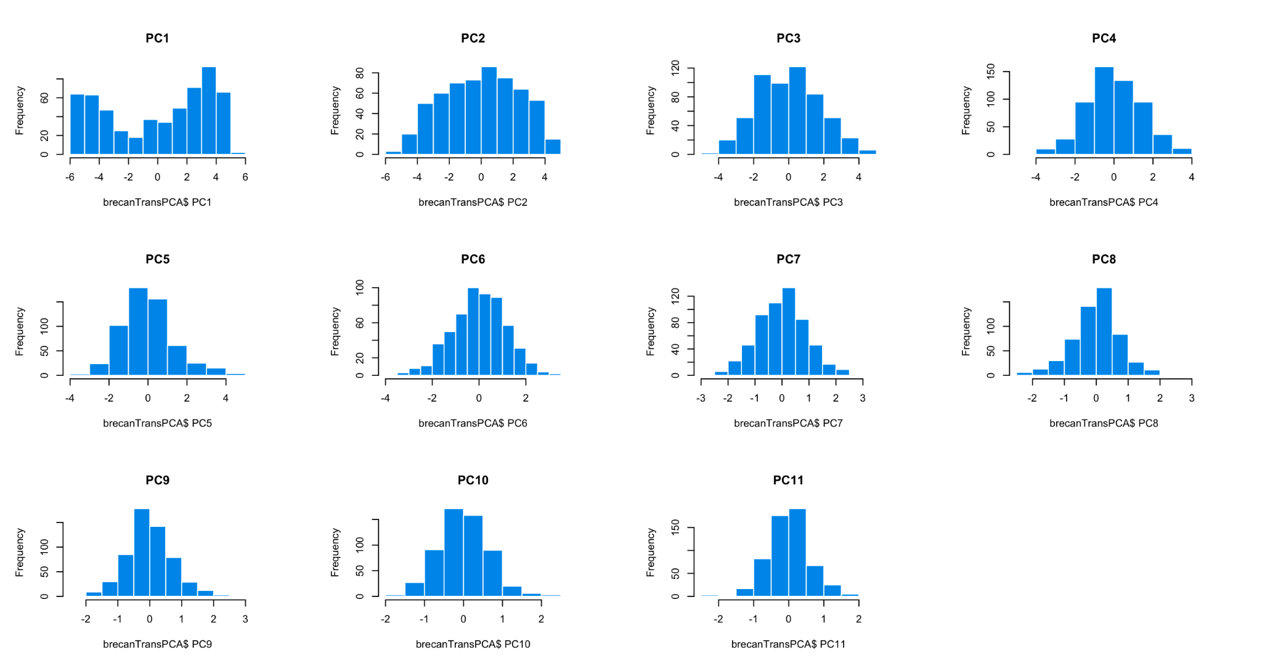
Data Transformation: “...what if” PCA was used ??
PCA needed 11 components to capture 95% of the variance
This feature reduction by PCA will use only 11 out of the 30 predictors — which may have a high impact on the sensitivity in the dataset.
Handling the collinearity by directly removing high correlated predictors with 0.8 threshold was considered the better alternative.
Breast Cancer Diagnosis

Slide 14
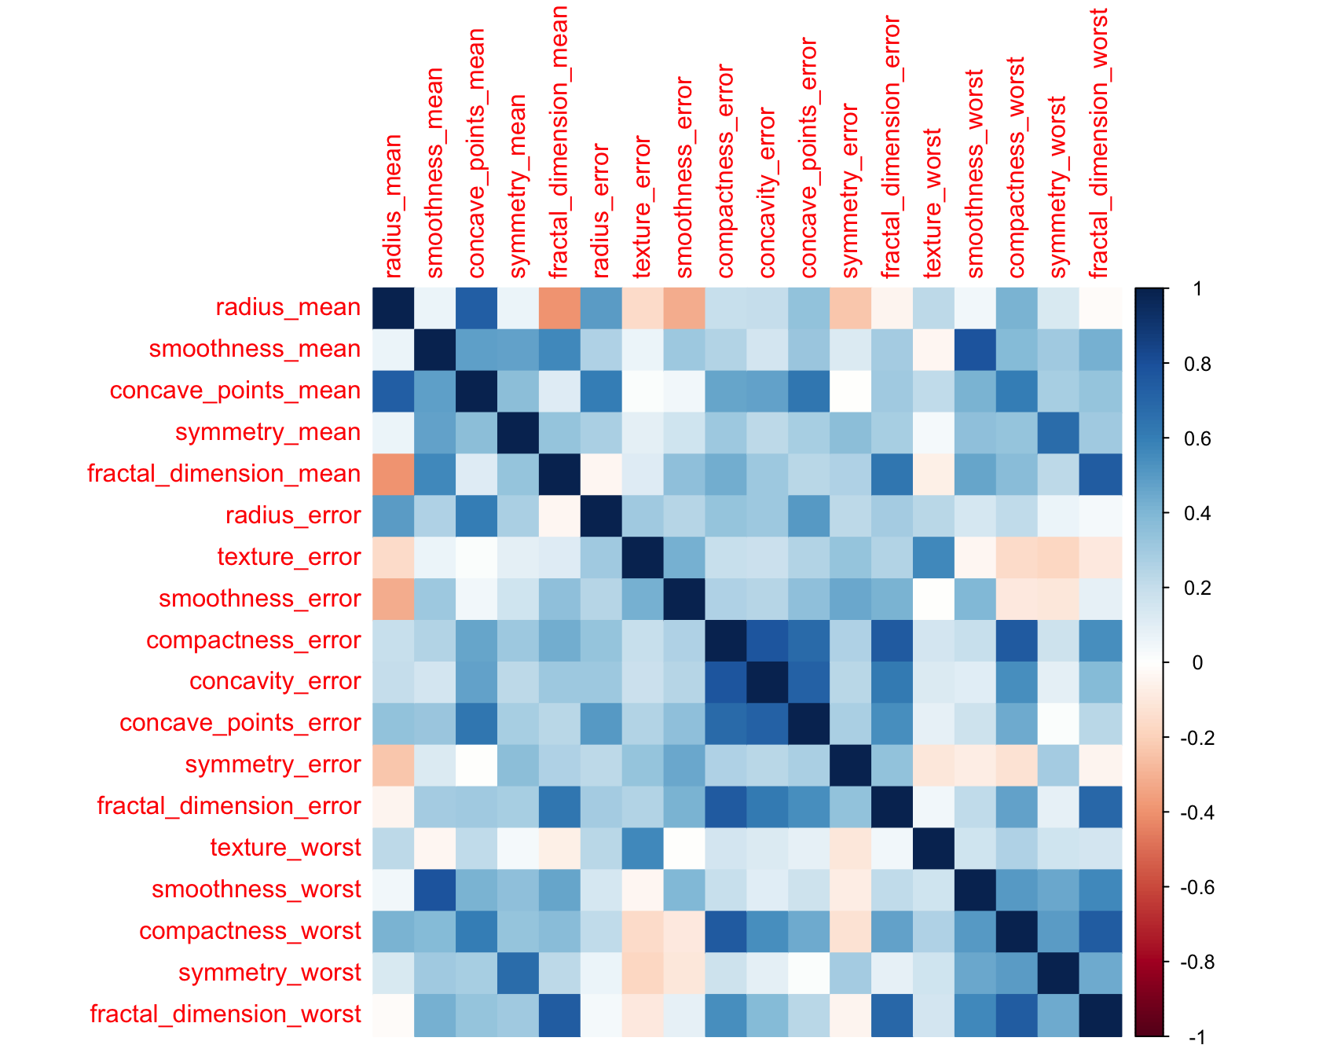
Data Anomalies: Correlation
Correlation matrix after removing 12 highly correlated predictors
18 predictors retained and will be used to train the model
Breast Cancer Diagnosis

Slide 15
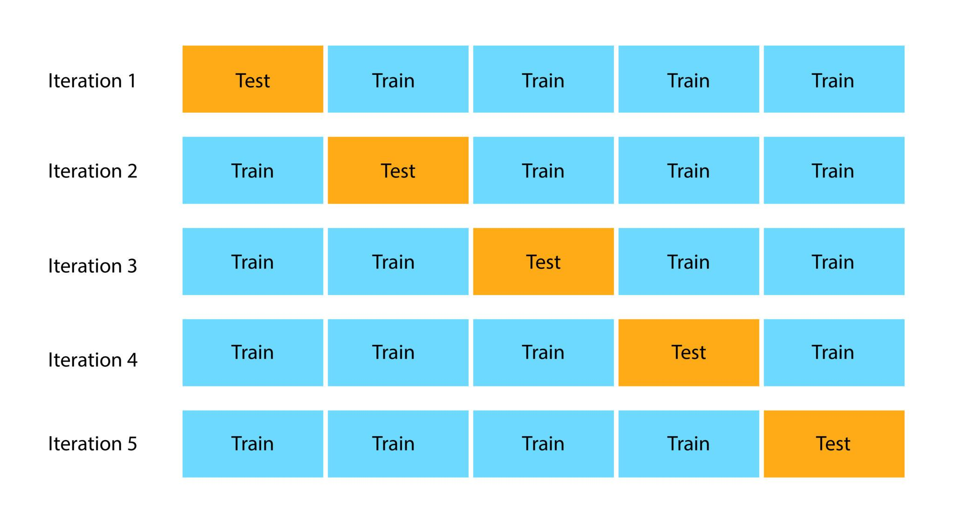
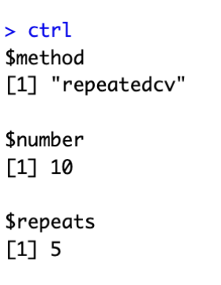
Spending Data
Splitting the data
Small sample size (569 < 1000). The initial strategy to use the entire dataset for training was reversed. Having a new, unseen dataset — as test data — for the model is equally crucial for better model performance (generalization of the model)
80% training. 20% for testing.
Stratified random sampling used.
Resampling technique:
Use k-Fold (10-Fold) Cross-Validation;
and repeat 5 times.
Breast Cancer Diagnosis

Slide 16
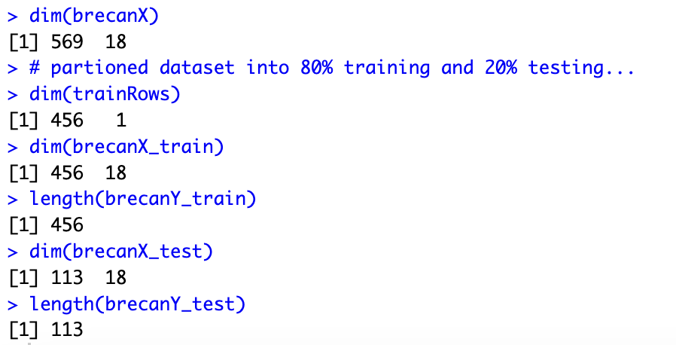
Spending Data
Data partition
After data (569 obs) was partitioned…
456 was used to train the model
113 was used to test the model
18 predictors were retained after data transformation
Breast Cancer Diagnosis

Slide 17
BUILDING MODELS
5 Linear classification models
8 Non-Linear classification models
Logistic Regression – LR | Quadratic Discriminant Analysis – QDA
Linear Discriminant Analysis – LDA | Regularized Discriminant Analysis – RDA
PLS Discriminant Analysis – PLSDA | Mixture Discriminant Analysis – MDA
Penalized models | Flexible Discriminant Analysis – FDA
Nearest Shrunken Centroids – NSC | Neural Networks – NNet
 | Support Vector Machines – SVM
 | K-Nearest Neighbors – KNN
 | Naive Bayes model — NB
Breast Cancer Diagnosis

Slide 18
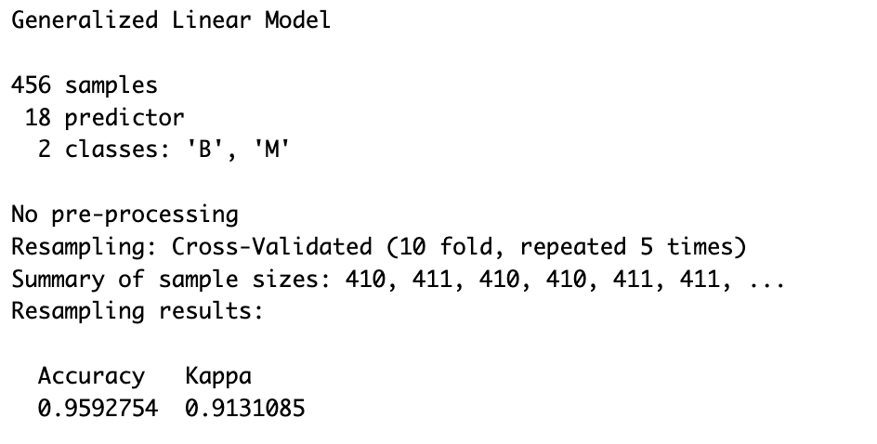
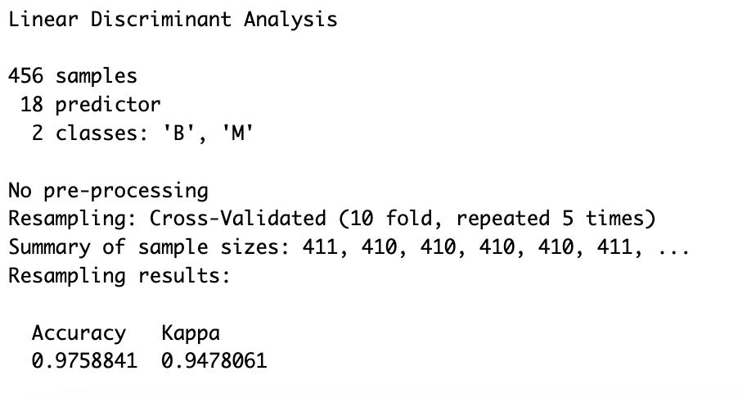
BUILDING MODELS
Train model: Logistic Regression
Train model: Linear Discriminant Analysis
No Model tuning plot available — no tuning parameter used.
No Model tuning plot available — no tuning parameter used.
Breast Cancer Diagnosis

Slide 19
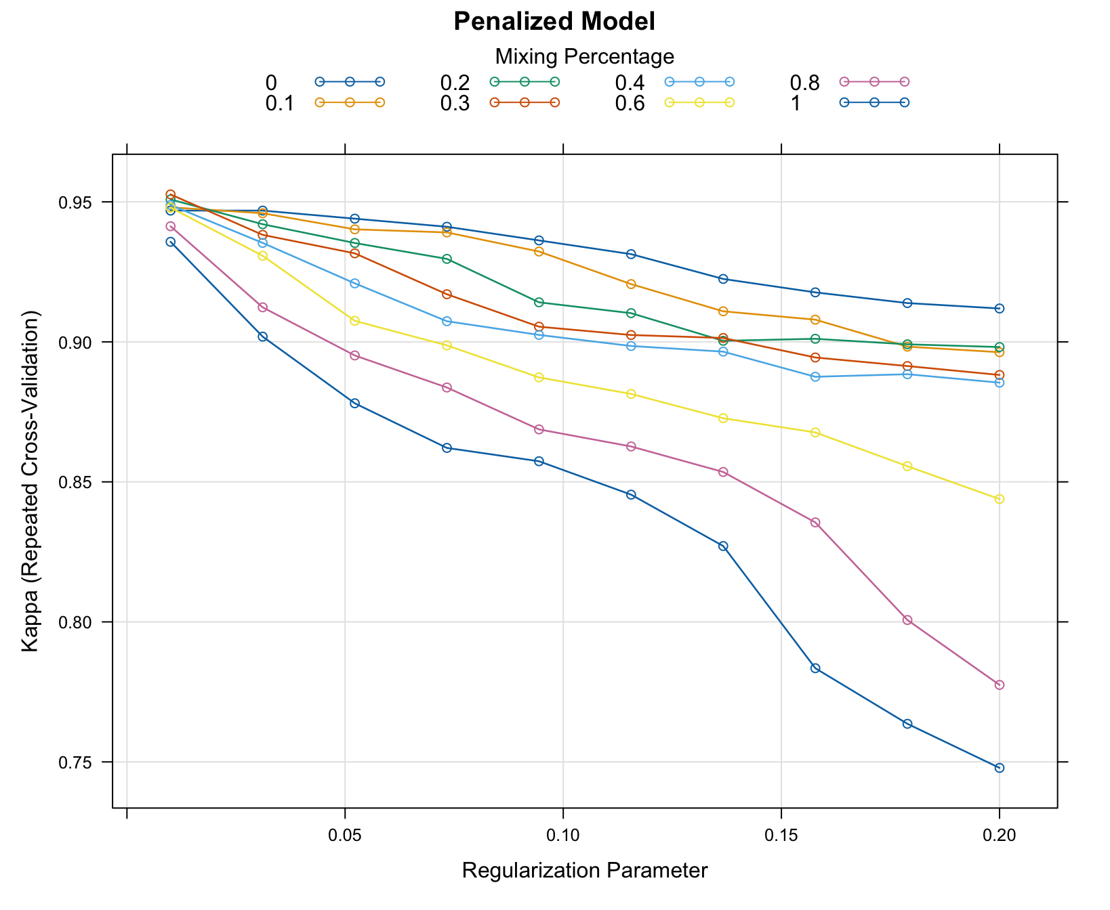
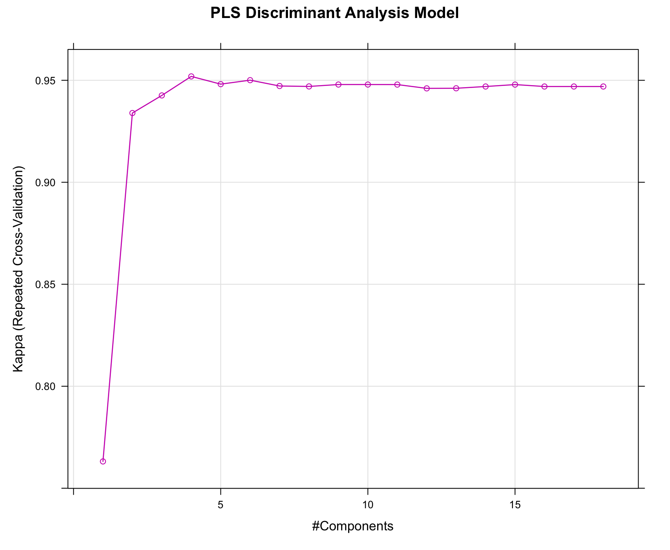
BUILDING MODELS
Train model: PLS Discriminant Analysis
Train model: Penalized models
Model tuning plot. Optimal model at “ncomp” = 4
Optimal model selected at:
lambda = 0.3. gamma=0.01
Breast Cancer Diagnosis

Slide 20
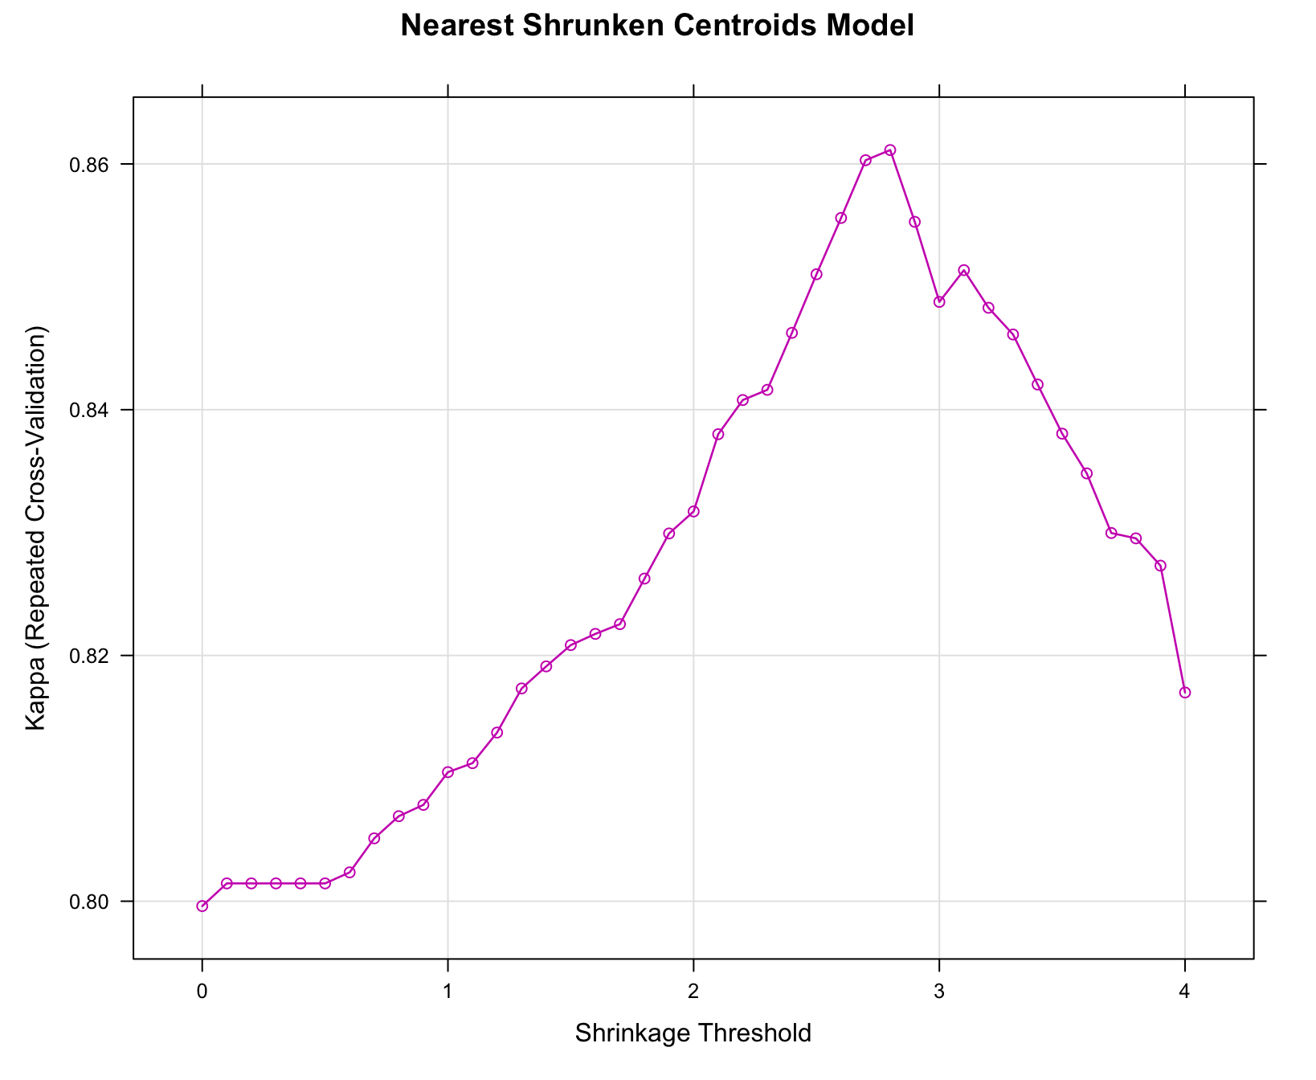
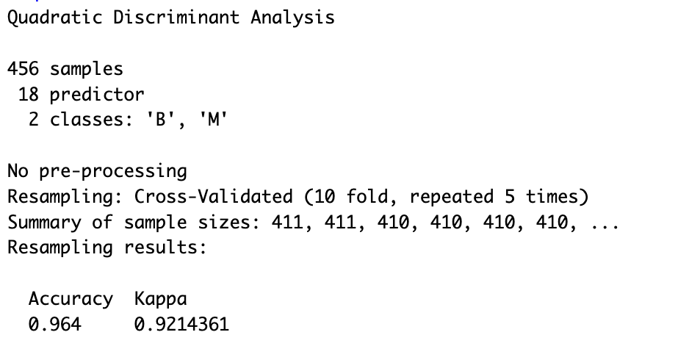
BUILDING MODELS
Train model: Nearest Shrunken Centroids
Train model: Quadratic Discriminant Analysis
No Model tuning plot available — no tuning parameter used.
Model tuning plot. Optimal model at shrinking threshold = 2.8
Breast Cancer Diagnosis

Slide 21
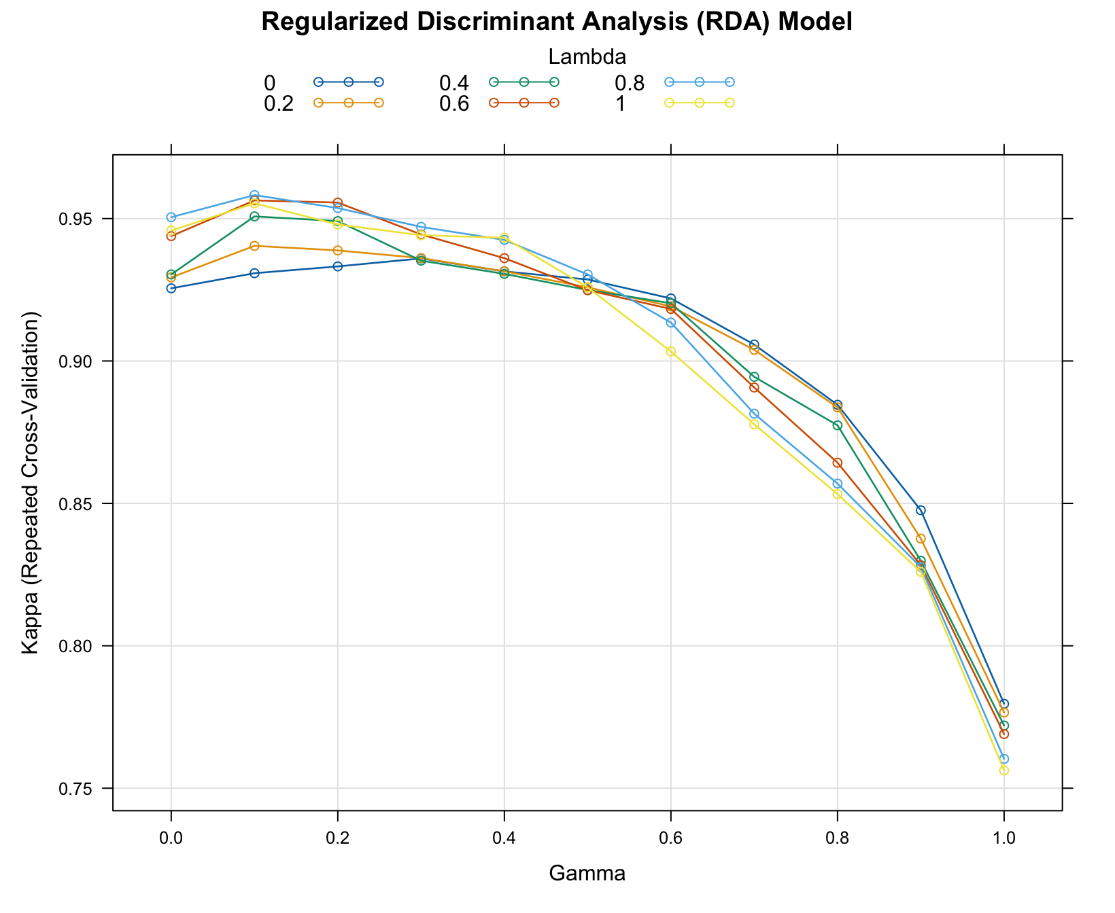
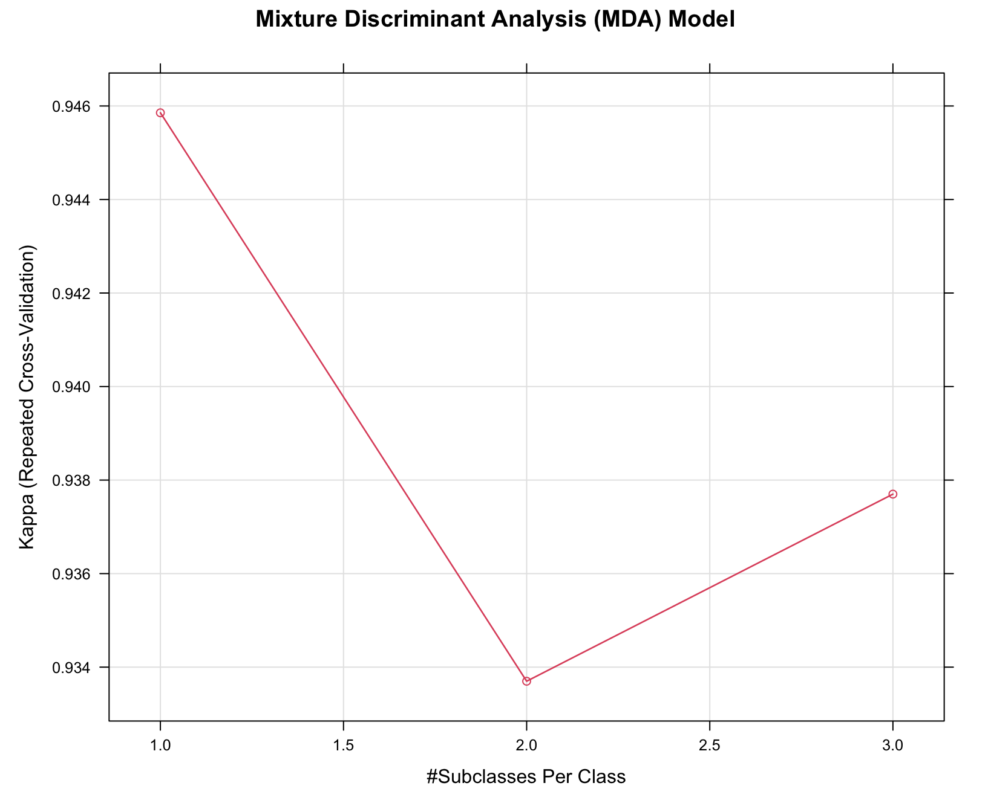
BUILDING MODELS
Train model: Regularized Discriminant Analysis model
Train model: Mixture Discriminant Analysis
Model tuning plot. Optimal model at “subclasses” = 1
Optimal model selected at:
gamma=0.1. lambda = 0.8.
Breast Cancer Diagnosis

Slide 22
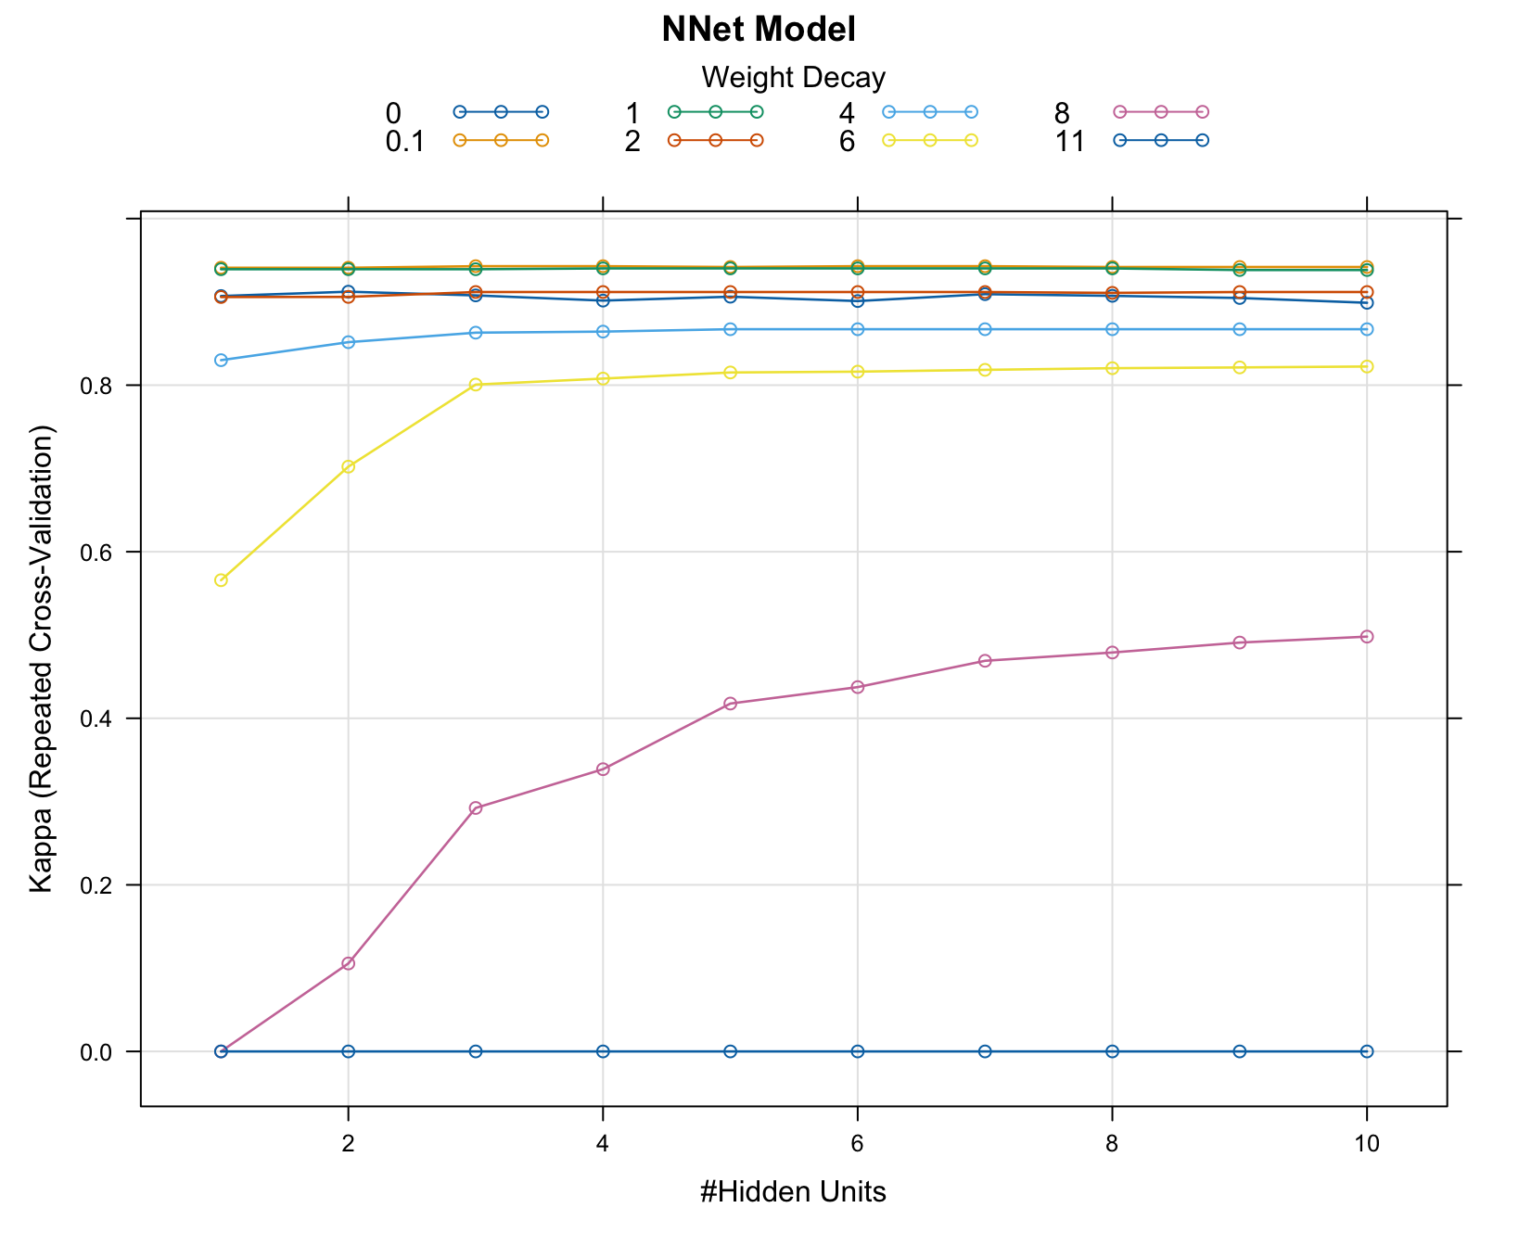
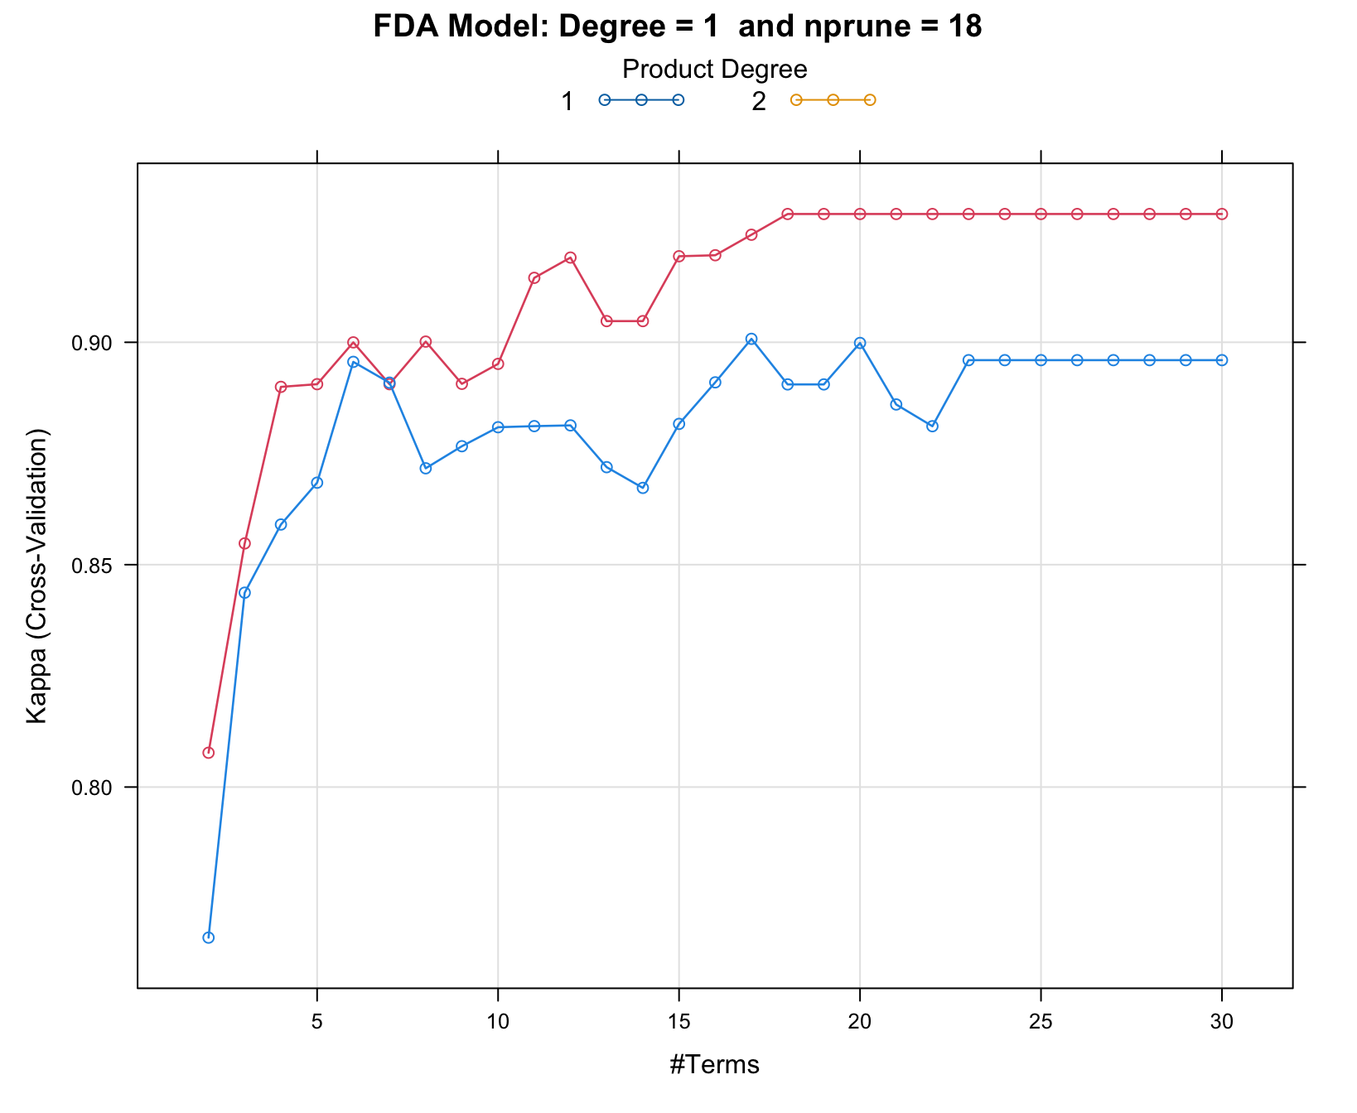
BUILDING MODELS
Train model: Neural Networks
Train model: Flexible Discriminant Analysis
Optimal model: 18 terms (nprune) retained at degree = 2
Model tuning plot. Optimal model at size = 3 and decay = 0.1
Breast Cancer Diagnosis

Slide 23
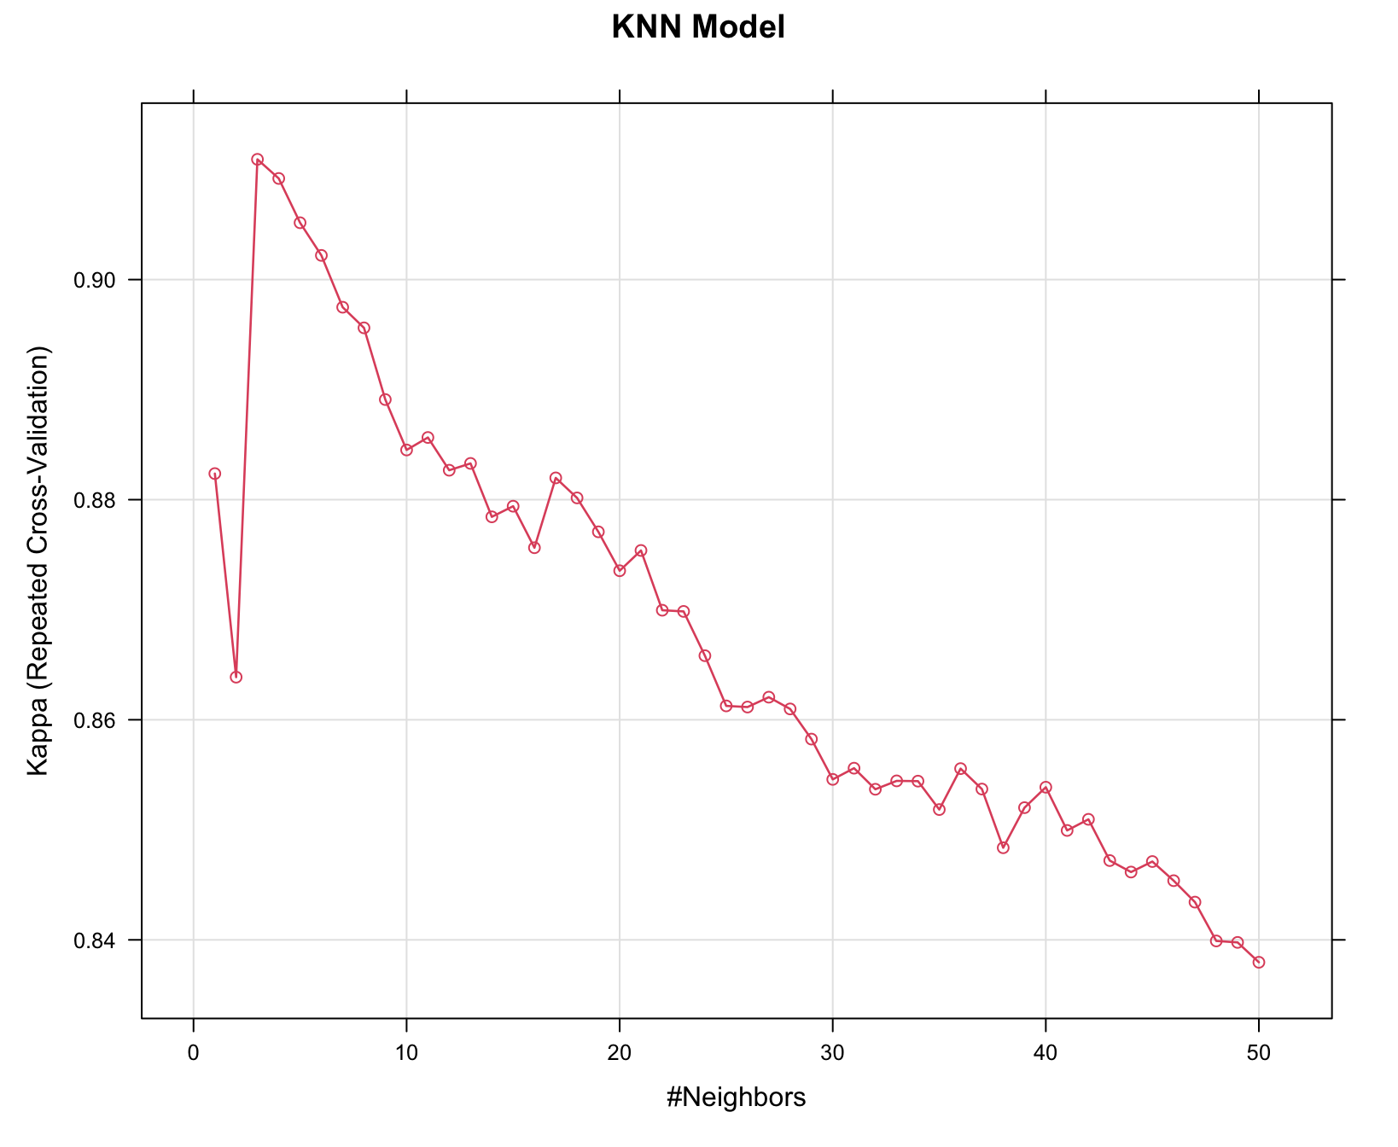
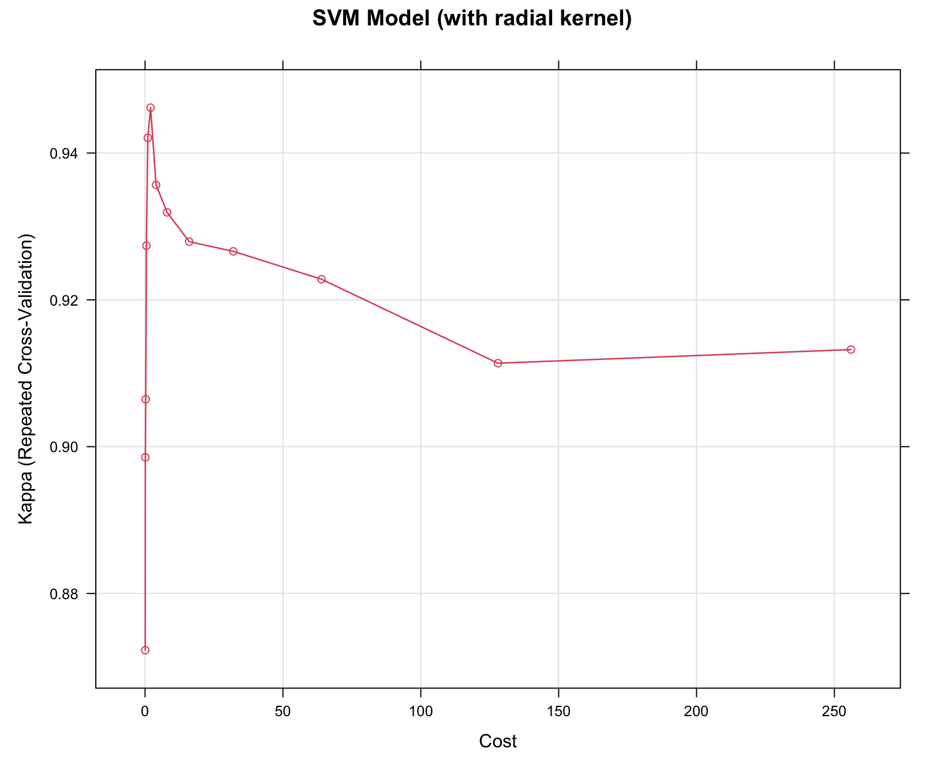
BUILDING MODELS
Train model: K-Nearest Neighbor (KNN)
Train model: Support Vector Machine (SVM)
Model tuning plot. Optimal model at Cost = 2. sigma was held constant.
Optimal model selected at: k = 3
Breast Cancer Diagnosis

Slide 24
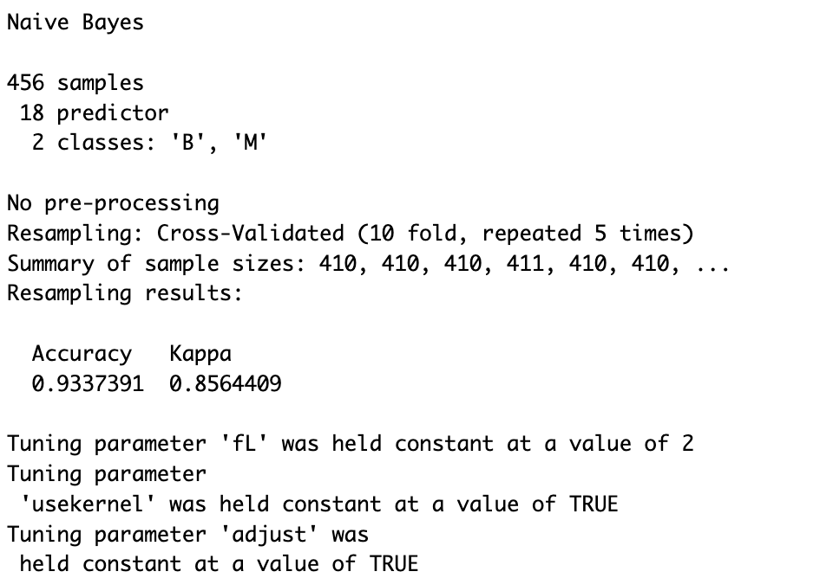
BUILDING MODELS
Train model: Naïve Bayes
Model tuning plot. No tuning parameter used for the model.
fL (Laplace correction) value was used to “smoothen” (control) the occurrences of zero probability estimates.
Breast Cancer Diagnosis

Slide 25
BUILDING MODELS
Summary Statistics Table
 | Model | Best Tuning Parameter | Training |  | Testing
 |  |  | AR | Kappa | AR | Kappa | ROC AUC
LINEAR MODELS | LR | None | 0.9593 | 0.9131 | 0.9646 ↑ | 0.9249 ↑ | 0.9990**
 | LDA | None | 0.9759 | 0.9478 | 0.9558 ↓ | 0.9075 ↓ | 0.9970
 | PLSDA | ncomp = 4 | 0.9776 | 0.9519 | 0.9558 ↓ | 0.9066 ↓ | 0.9963
 | Penalized | alpha = 0.3, lambda = 0.01 | 0.9780* | 0.9527* | 0.9646 ↓ | 0.9257 ↓ | 0.9977
 | NSC | threshold = 2.8 | 0.9364 | 0.8611 | 0.9381 ↑ | 0.8680 ↑ | 0.9805
LINEAR MODELS | QDA | None | 0.9640 | 0.9214 | 0.9558 ↓ | 0.9048 ↓ | 0.9930
 | RDA | Gamma = 0.1, lambda = 0.8 | 0.9808** | 0.9583** | 0.9646 ↓ | 0.9257 ↓ | 0.9966
 | MDA | subclasses = 1 | 0.9750 | 0.9459 | 0.9558 ↓ | 0.9075 ↓ | 0.9970
 | NNet | size = 3, decay = 0.1 | 0.9732 | 0.9429 | 0.9646 ↓ | 0.9249 ↓ | 0.9987*
 | FDA | degree = 1, nprune = 18 | 0.9671 | 0.9288 | 0.9381 ↓ | 0.8693 ↓ | 0.9903
 | SVM | cost, C = 2 | 0.9749 | 0.9462 | 0.9558 ↓ | 0.9057 ↓ | 0.9966
 | KNN | k = 3 | 0.9583 | 0.9109 | 0.9381 ↓ | 0.8693 ↓ | 0.9792
 | NB | None | 0.9337 | 0.8564 | 0.9204 ↓ | 0.8303 ↓ | 0.9826
Breast Cancer Diagnosis

Slide 26
BUILDING MODELS
Choosing the Best Two (2) Models from Training
Kappa statistic was used to train or fit the models. Kappa was considered first followed by accuracy rate metric.
High Kappa values indicate there is a strong concordance —agreement between predictors and the response variable.
All models except “LR and NSC” reduced in the evaluation metrics used on test.
Regularized Discriminant Analysis (RDA) model.
Kappa value of 95.83%
Accuracy value of 98.08%
Penalized model
Kappa value of 95.27%
Accuracy value of 97.80%
Breast Cancer Diagnosis

Slide 27
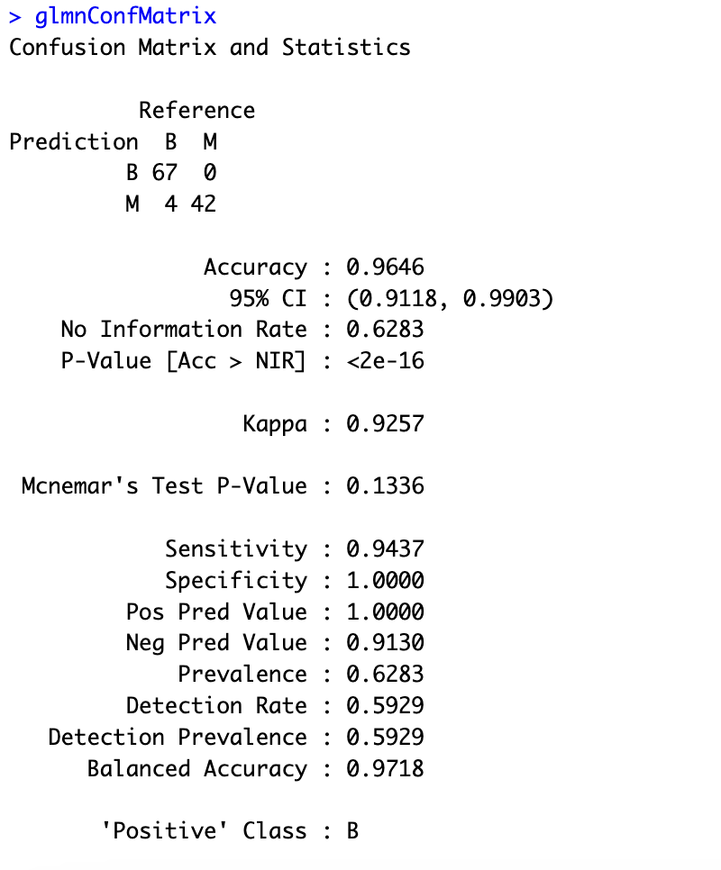
BUILDING MODELS
Best Model (Penalized Model) — Confusion Matrix
Predicting on the test data, the two best models RDA and Penalized coincidentally had the same values for Kappa and Accuracy rate; as well as Sensitivity and Specificity.
The ROC AUC value for the penalized model was a little better than the RDA.
RDA model tend to underfit the model a little bit more compared to the Penalized model.
Breast Cancer Diagnosis

Slide 28
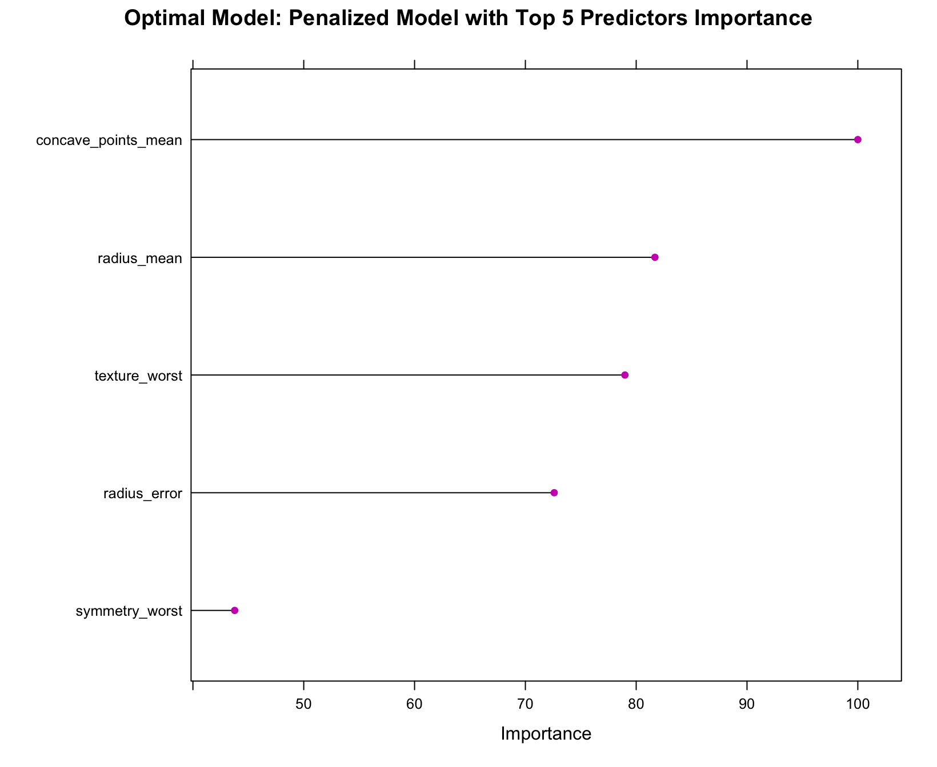
Best Model: Penalized Model
Important Predictors
The top 5 predictors using the best model in order of importance are as follows:
# | Predictor | Overall
1 | concave_points_mean | 100.000
2 | radius_mean | 81.691
3 | texture_worst | 78.984
4 | radius_error | 72.602
5 | symmetry_worst | 43.768
Breast Cancer Diagnosis

Slide 29
THANK YOU

